Slide 1
PREDICTION OF THE MEAN RATING FOR A MOVIE
DATA ANALYTICS PROJECT PRESENTATION
Michelle Zanotti [1038859]
Antonio Iannotta [1024859]

Slide 2
In this presentation:
Introduction
Methodology
Traditional non-deep supervised ML techniques
Supervised ML techniques based on neural networks
Supervised ML technique with deep models for TabularData
Implementation
Traditional non-deep supervised ML techniques
Supervised ML techniques based on neural networks
TabNet
Results
Traditional non-deep supervised ML techniques
Supervised ML techniques based on neural networks
TabNet

Slide 3
INTRODUCTION

Slide 4
Introduction
GOAL: prediction of the mean rating for a certain film starting from its characteristics.
DATA: MovieLens 25M dataset, composed of several files in which are stored the characteristics of the movies.
FILES
tags.csv : tags that can be assigned by a specific user.
movies.csv : relevant informations about every movie (movieId for a film, the title of the film and the genre or the several genres)
genome tags.csv : list of the possible assignable tags
genome scores.csv : relevance of every tag for every film.
ratings.csv : list of ratings for the movies.

Slide 5
METHODOLOGY

Slide 6
Methodology
To reach the goal of the analysis → use of various techniques and approaches based on regression
Three different independent tasks but with the same goal:
Traditional non-deep supervised ML techniques
Supervised ML techniques based on neural networks
Supervised ML technique with deep models for Tabular Data

Slide 7
Methodology
The methodological approach followed during the development of the various tasks followed the several steps of data analytics pipeline:
Data acquisition
Data visualization
Data pre-processing
Modelling
Performance evaluation

Slide 8
Methodology: Traditional non-deep supervised ML techniques
Linear Regression
basis of the regression
to obtain the estimate of a function a parametric approach is used by calculating the parameters (coefficients) that constitute it
KNN Regressor
use of a method based on the calculation of distances
(adaptation of the knn classifier)
Random Forest Regressor
being a tree-based assembly method it should increase performance even if overfitting is more likely

Slide 9
Methodology: Supervised ML techniques based on neural networks
To develop an approach based on neural networks, three fundamental elements were necessary:
the creation of a data layer
the architecture of the network → deep feedforward network (multi layer perceptions)
training and the evaluation process

Slide 10
Methodology:Supervised ML technique with deep models for Tabular Data
Supervised ML technique with deep models for Tabular Data → TabNet.
high-performance and interpretable canonical deep tabular data learning architecture canonical DNN architecture for tabular data
Usage of sequential attention to choose which features to reason from at each decision step
the learning capacity is used for the most salient features → interpretation and learning are more efficient

Slide 11
Methodology:Supervised ML technique with deep models for Tabular Data
The main features of TabNet are:
Receiving raw tabular data inputs without any preprocessing and is trained using gradient descent-based optimization.
Using sequential attention to choose which features to reason from at each decision step. Selecting features in this way is instance-wise, e.g. it can be different for each input, and TabNet employs a single deep learning architecture for feature selection and reasoning.
Two kinds of interpretability:
local interpretability that visualizes the importance of features and how they are combined
global interpretability which quantifies the contribution of each feature to the trained model

Slide 12
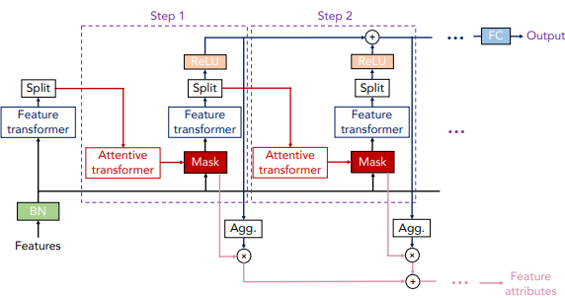
Methodology:Supervised ML technique with deep models for Tabular Data
The TabNet encoder
sequential multi-step, where inputs go from step to step
A step is composed of:
feature transformer
attentive transformer
feature masking
A split block divides the processed representation to be used by the attentive transformer of the subsequent step as well as for the overall output.
For each step:
the feature selection mask provides interpretable information about the model’s functionality
the masks can be aggregated to obtain global feature important attribution.

Slide 13
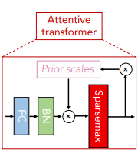
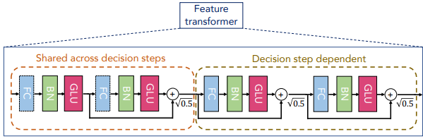
Methodology:Supervised ML technique with deep models for Tabular Data
Attentive Transformer
Feature Transformer
Normalization with 0.5 helps to stabilize learning by ensuring that the variance throughout the network does not change dramatically.

Slide 14
Methodology:Supervised ML technique with deep models for Tabular Data
Aggregation
The outputs of each decision step are combined in a linear way.
It quantifies aggregate feature importance in addition to analysis of each step
Combining the masks at different steps → a coefficient that can weigh the relative importance of each step in the decision
ηb[i]:
denotes the aggregate decision contribution at i-th decision step for the b-th sample.
As its value increases, it plays a higher role in the overall linear combination.
used to scale the decision mask at each decision step obtaining the aggregate feature importance mask.
Feature selection → carry out a soft selection of the salient features by creating a mask (M[i]) using an attentive transformer that allows to obtain the masks using the processed features from the preceding step;
The input is:
passed into a fully connected layer followed by Batch normalization
multiplied with the Prior scale, it returns P[i], the prior scale term:
P[0] is equal to 1, so all features are equal
P[i] is equal to ∏ij=1(γ − M [J]) → relaxation parameter γ
passed into sparsemax layer: some features adding up to 0 (unused) and only the rest will add up to 1. help in making it an instance-wise feature selection where different features are taken at different steps.
Fed to the mask layer which helps to identify the selected features.
Feature processing
processing of the filtered features using a feature transformer
division by the output of the decision phase (d[i]) and the information for the next phase (a[i])
construction the overall decision embedding ∑N steps i=1 ReLU (d[i]) dout
application of the linear mapping Wf inaldout to obtain the output mapping

Slide 15
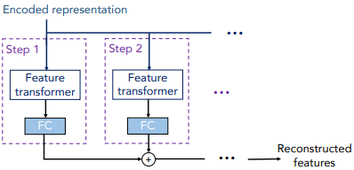
Methodology:Supervised ML technique with deep models for Tabular Data
The TabNet decoder
used to perform Tabular self-supervised learning by re-constructing the tabular features from the TabNet encoded representation.
It is composed of
feature transformers
fully-connected layers at each decision step
The outputs are summarized to obtain the reconstructed features.
What is done
the prediction of the missing columns from those present by exploiting the binary mask S multiplied with the last FC layer
the input coming from the encoder is given by (1 − S) · ＾f

Slide 16
IMPLEMENTATION

Slide 17
Implementation: Traditional non-deep supervised ML techniques
Three different models trained in this task:
Linear regression
KNRegressor
RandomForest Regressor
The several steps applied to each model are the following:
Scaling
PCA (70%)
Hyperparameter Tuning
Evaluation of performance

Slide 18
Implementation: Supervised ML techniques based on neural networks
For this task have been performed:
definition of architecture
definition of data layer
definition of train and test model
The execution, in order to evaluate the performance, has been performed with dropout and without dropout, in order to make a comparison.

Slide 19
Implementation: TabNet
The last task required to use the tabular NN. In this step a Tabular neural network has been created starting from the TabNet model and just changing some parameters (like the one to auto select the best learning rate).

Slide 20
RESULTS

Slide 21
Results: Traditional non-deep supervised ML techniques
In the following are reported the results for the first task
Algorithm | MSE | R^2
KNN regressor | 0.04313929340398458 | 0.8127800038849485
Linear regression | 0.010761137943908726 | 0.9532977931468383
RandomForest Regressor | 0.08046306577307188 | 0.6507987574027296

Slide 22
Results:Supervised ML techniques based on neural networks
In the following are reported the results for this task
Dropout | Loss | R2
No | 0.03749039024114609 | 0.84
Yes | 0.06291425973176956 | 0.63

Slide 23
Results:TabNet
In the following is reported the results for the best TabNet model
MAE | MSE | R2
0.1651230036436534 | 0.043966363347998964 | 0.803270316811896

